Slide 1
NT219- Cryptography
Week 09: Hash Function and Message Authentication Codes
PhD. Ngoc-Tu Nguyen
tunn@uit.edu.vn

Slide 2
Security goals
Goals
Cipher systems
- Symmetric (DES, AES)
- Asymmetric (RSA, ECC, CRYSTALS-KYBER)
Confidentiality
Privacy
Integrity
Hash functions
Message authentication code (MAC)
Digital signature (digital certificate)
Authentication
Non-repudiation (Accountability)
Access control
RBAC, ABAC, PBAC
Availability

Slide 3
Outline
Motivations
Hash function
CRC
Cryptographic Hash function
SHA2, SHA3
Message authentication code
Notes:
Cipher=a secret system of writing;

Slide 4
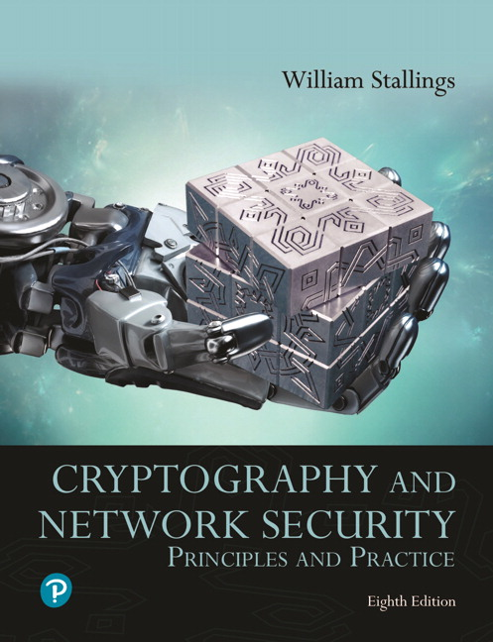
Textbooks and References
Text books
[1] Chapter 11,12

Slide 5
Motivations
(2) MITM
A
B
(1)
propagation errors!
Who are we communication with?
Does the destination data original form?
Needs:
a way to ensure that data arrives at destination in its original form sent by the sender;
it is coming from an authenticated source (user, server, mediate node).
Notes:
Modified ciphertext can often still be decrypted into plaintexts?

Slide 6
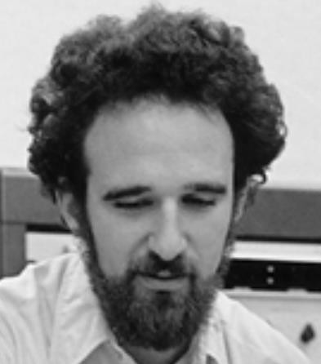
















Motivations
$$Q_{A}$$
$$(a,Q_{A}=aG)$$
$$Q_{B}$$
$$(b,Q_{B}=bG)$$
$$sk=aQ_{B}=bQ_{A}=abG$$
Bob
Alice
Need authentication entities
man-in-the-middle attack!
$$mG$$
$$aG$$
$$mG$$
$$bG$$
$$(a,Q_{A}=aG)$$
$$(b,Q_{B}=bG)$$
$$sk_{1}=amG$$
$$(m,Q_{M}=mG)$$
$$sk_{2}=bmG$$

Slide 7








Warmup: Man-in-the-Middle (MiTM) attacks
Need authentication entities
man-in-the-middle attack!
$$mG$$
$$aG$$
$$mG$$
$$bG$$
$$(a,Q_{A}=aG)$$
$$(b,Q_{B}=bG)$$
$$sk_{1}=amG$$
$$(m,Q_{M}=mG)$$
$$sk_{2}=bmG$$
https://csrc.nist.gov/csrc/media/projects/cryptographic-standards-and-guidelines/documents/examples/sha256.pdf

Slide 8
Cryptographic Ciphers
Symmetric Cipher (DES, AES)
Asymmetric Cipher (RSA, ECC, ElGamal)
can provide which security services?
Confidentiality ☑
Integrity 
Privacy ☑
Authentication 
Non-repudiation 
Availability 

Slide 9
Hash function and MACs
Hash function
Message Authentication Codes (MAC)
Digital signature
Digital certificate
symmetric
asymmetric
Integrity ☑
can provide
Authentication ☑
Availability ☑
Further reading (Wikipedia)
Cryptographic Hash Functions
Message Authentication Code
Non-repudiation ☑

Slide 10
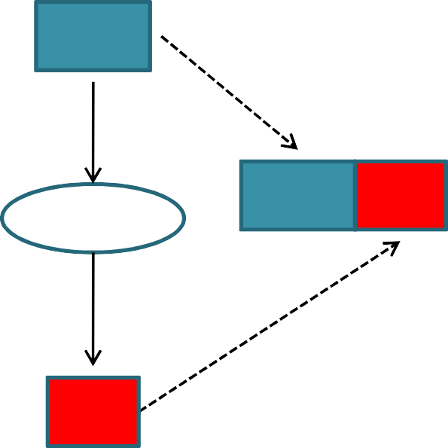

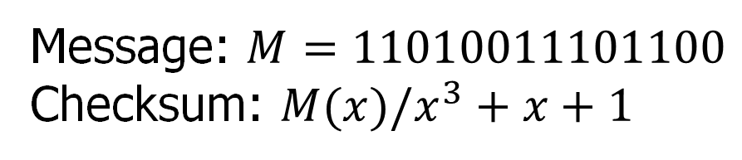
Hash function: An example
CRC Checksum in Networking
Sender
Receiver
M
M
ChkS um
INTERNET
M
Chk Sum
CRC
CRC
Chk Sum
= ?
Chk Sum’
Message: $M=11010011101100$
Checksum: $M(x)/x^{3}+x+1$

Slide 11

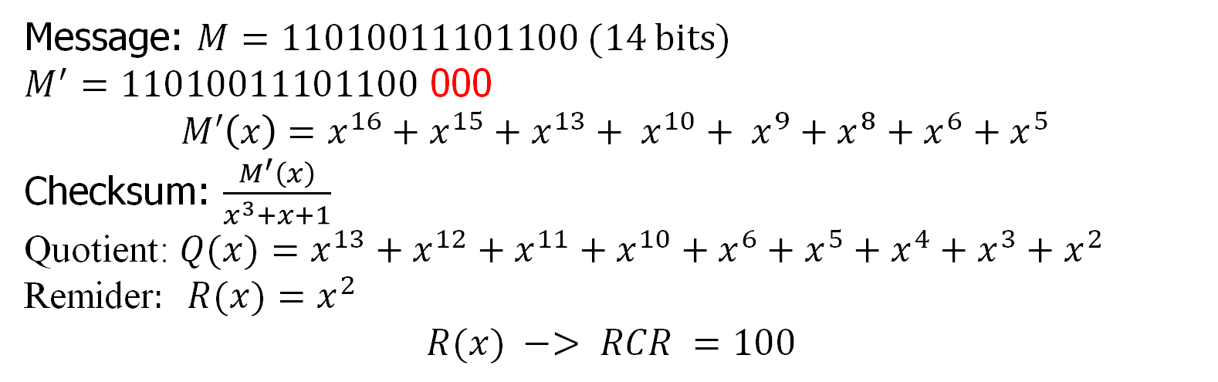
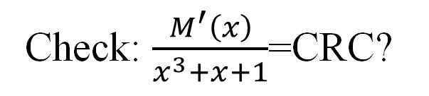


Hash function: An example
CRC Checksum in Networking
$$H:{\left\{0,1\right\}}^{∗}→{\left\{0,1\right\}}^{3}$$
Message: $M=11010011101100 (14 bits)$ $M^{′}=11010011101100$ 000 $$M′\left(x\right)=x^{16}+x^{15}+x^{13}+ x^{10}+ x^{9}+x^{8}+x^{6}+x^{5}$$
Checksum: $\frac{M^{′}\left(x\right)}{x^{3}+x+1}$
Quotient: $Q(x)=x^{13}+x^{12}+x^{11}+x^{10}+x^{6}+x^{5}+x^{4}+x^{3}+x^{2}$ Remider$: R(x)=x^{2}$
$$R(x) −> RCR =100$$
Sender
Receiver
(M||CRC)
$$11010011101100 100$$
$$11010011101100 100$$
(M’||CRC)
https://en.wikipedia.org/wiki/Cyclic_redundancy_check
Check: $\frac{M^{′}\left(x\right)}{x^{3}+x+1}$=CRC?

Slide 12



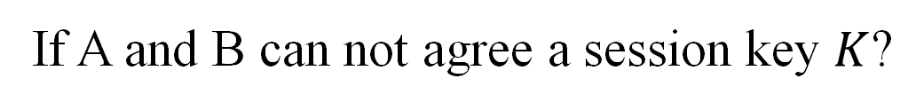

Motivations
How to ensure that the message is the original one?
How to verify that a message comes from the claimed sender?
Integrity?
Authentication?
Message Authentication Code (MAC)
If A and B can not agree a session key $K$?
Alice
Bob
$$M, tag=CRC$$
$$send M?$$
$$M^{′},tag^{′}=?tag$$
attacks?
$$M=M′$$

Slide 13
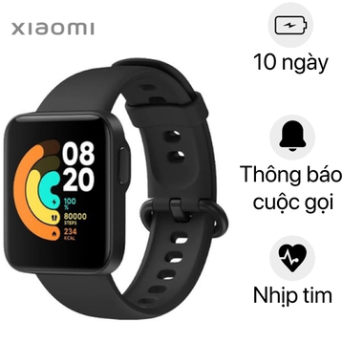





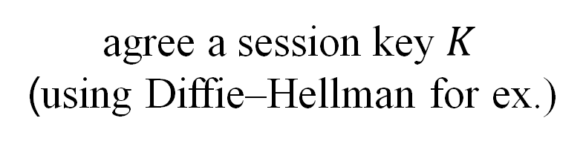

Motivations
How to ensure that the message is the original one?
How to verify that a message comes from the claimed sender?
Integrity?
Authentication?
MAC, HMAC
agree a session key $K$
(using Diffie–Hellman for ex.)
Health care system
server
Elder
$$K$$
$$K$$
$$M, tag=HMAC\left(K,M\right)=H(K,M)$$
$$send M?$$
$$M^{′},tag$$
$H\left(K,M^{′}\right)=?tag=$ $H\left(K,M\right)$
$$M=M′$$

Slide 14
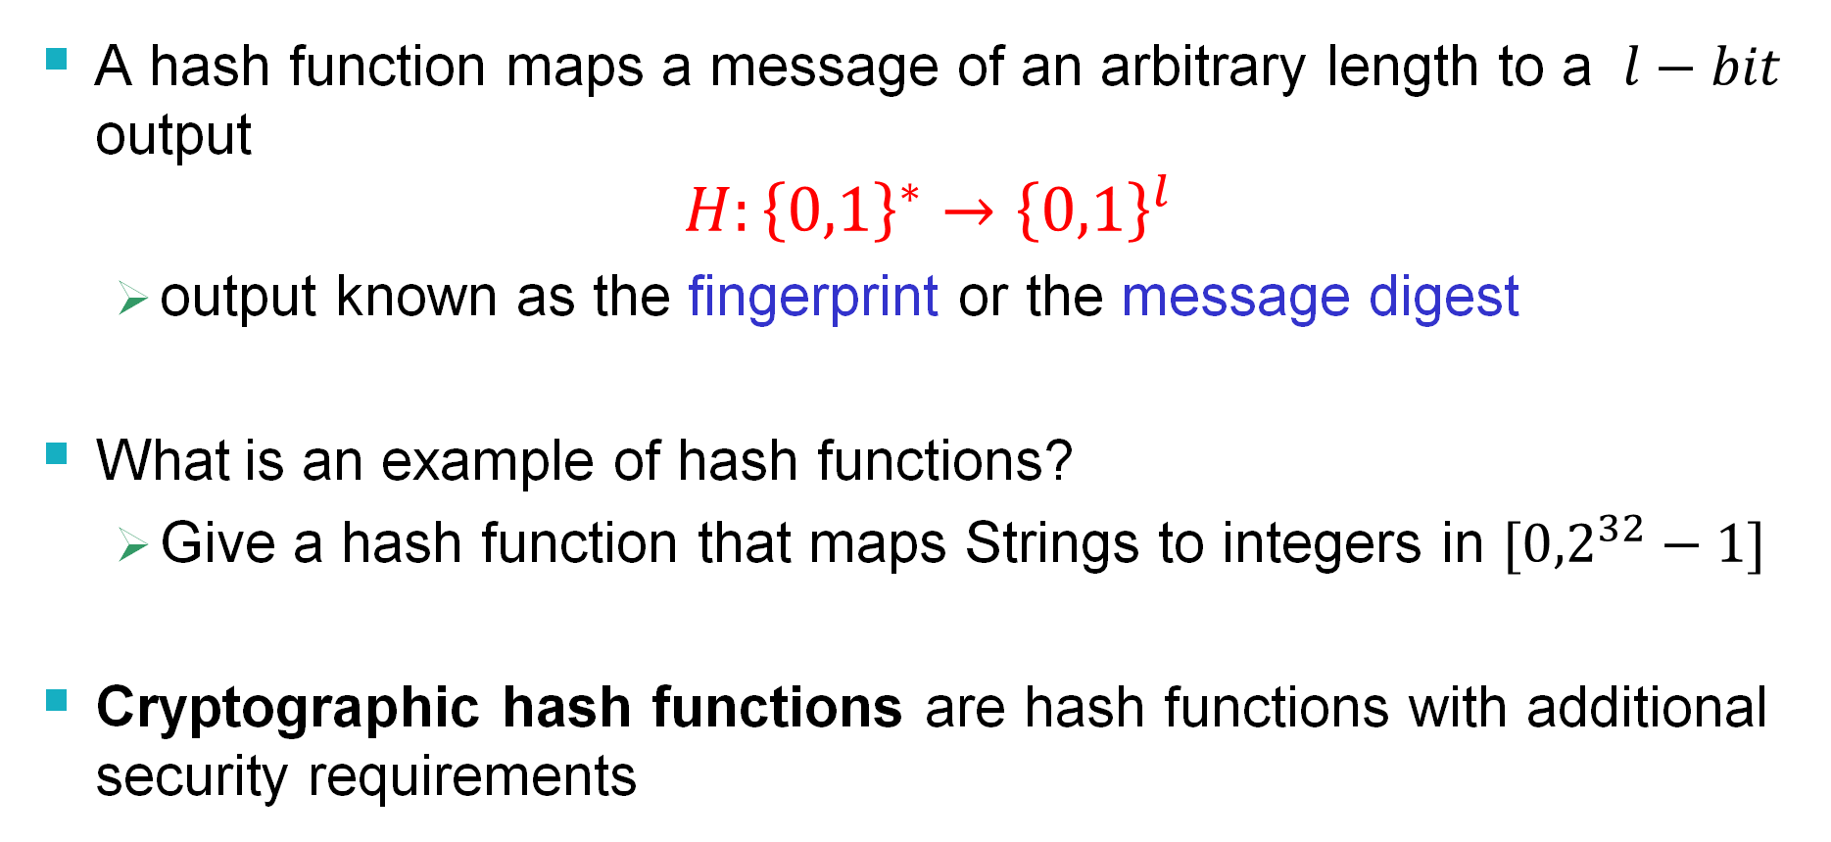
Hash Functions
A hash function maps a message of an arbitrary length to a $l−bit$ output
$$H:{\left\{0,1\right\}}^{∗}→{\left\{0,1\right\}}^{l}$$
output known as the fingerprint or the message digest
What is an example of hash functions?
Give a hash function that maps Strings to integers in $[{0,2}^{32}−1]$
Cryptographic hash functions are hash functions with additional security requirements
Notes:
Example hash function: v:=1; for each character c, v=v*(c+1)+2 mod 2^{32};

Slide 15
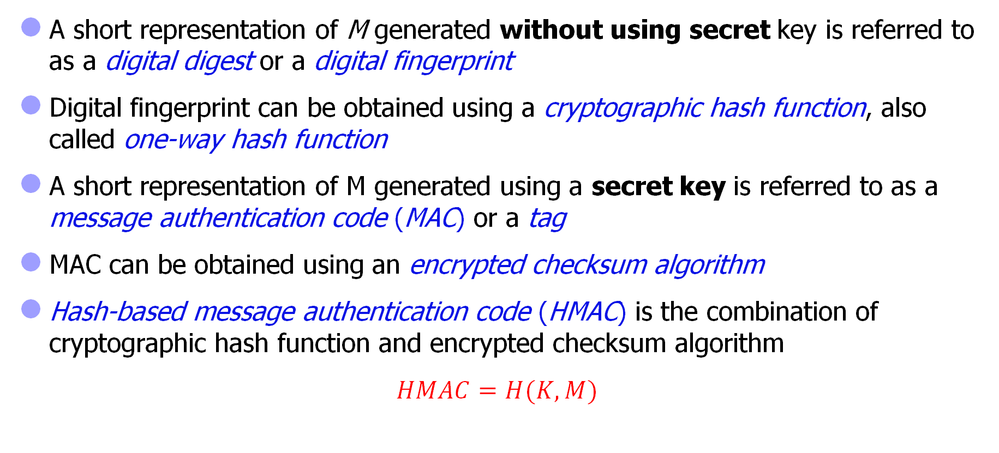
Some terminology
A short representation of M generated without using secret key is referred to as a digital digest or a digital fingerprint
Digital fingerprint can be obtained using a cryptographic hash function, also called one-way hash function
A short representation of M generated using a secret key is referred to as a message authentication code (MAC) or a tag
MAC can be obtained using an encrypted checksum algorithm
Hash-based message authentication code (HMAC) is the combination of cryptographic hash function and encrypted checksum algorithm
$HMAC=H(K,M)$

Slide 16
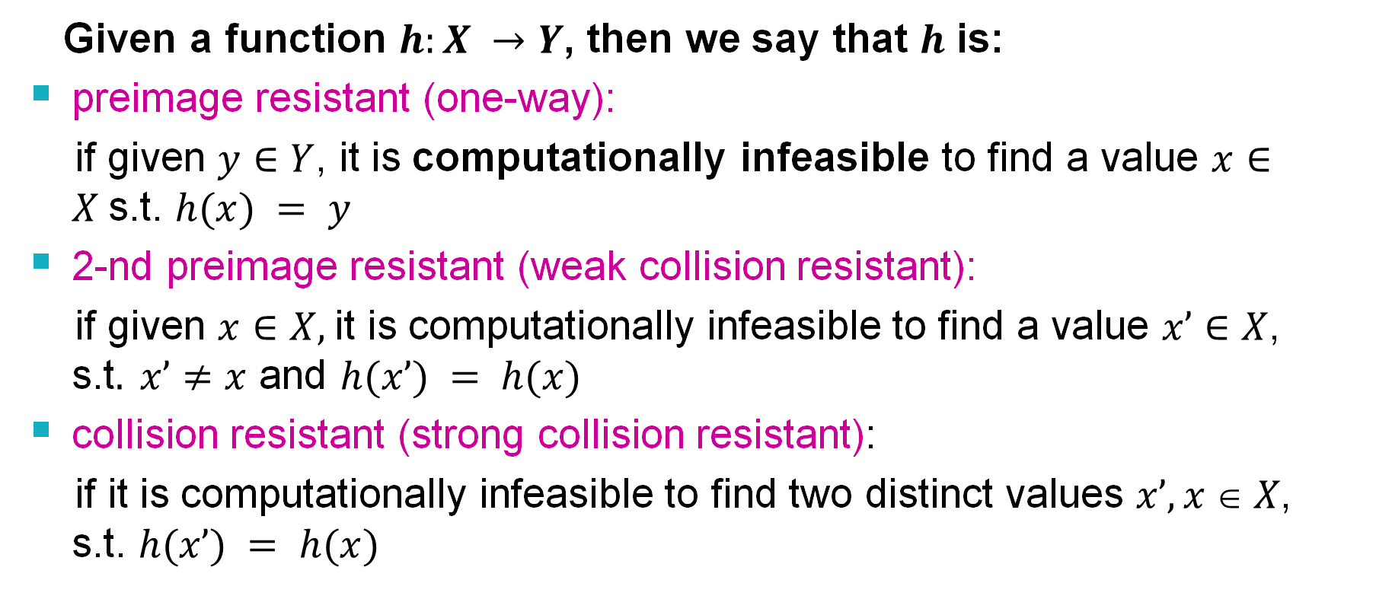
Cryptographic Hash Functions
Given a function $h:X →Y$, then we say that $h$ is:
preimage resistant (one-way):
if given $y∈Y$, it is computationally infeasible to find a value $x∈X$s.t. $h(x) = y$
2-nd preimage resistant (weak collision resistant):
if given $x∈X,$it is computationally infeasible to find a value $x’∈X$, s.t$. x’≠x$ and $h(x’) = h(x)$
collision resistant (strong collision resistant):
if it is computationally infeasible to find two distinct values $x’,x  X$, s.t. $h(x’) = h(x)$

Slide 17
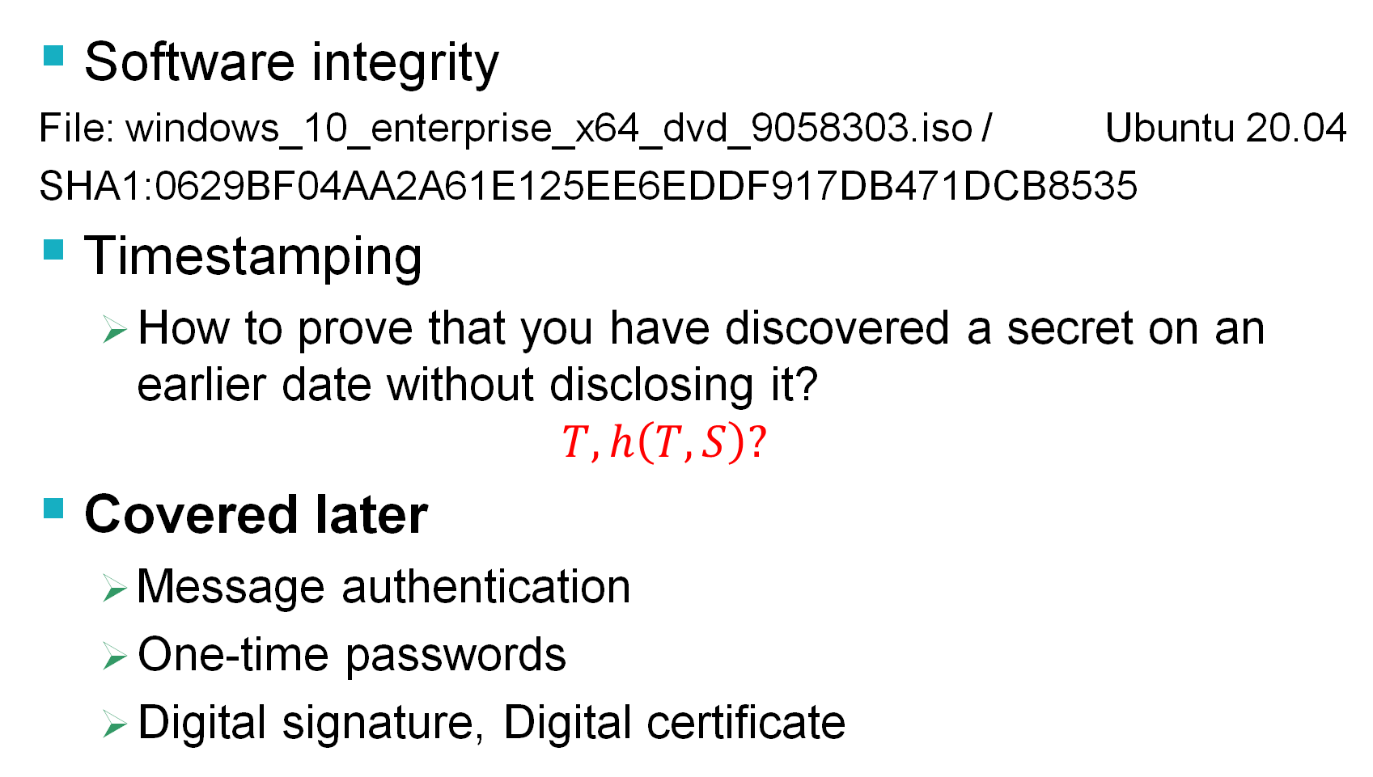
Usages of Cryptographic Hash Functions
Software integrity
File: windows_10_enterprise_x64_dvd_9058303.iso / Ubuntu 20.04
SHA1:0629BF04AA2A61E125EE6EDDF917DB471DCB8535
Timestamping
How to prove that you have discovered a secret on an earlier date without disclosing it?
$$T, h\left(T,S\right)?$$
Covered later
Message authentication
One-time passwords
Digital signature, Digital certificate
UBUNTO 20 ISO
Further reading
https://en.wikipedia.org/wiki/Cryptographic_hash_function

Slide 18


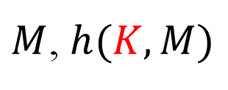





Using Hash Functions for Message Integrity
Is this secure scheme (M cannot be modified)?
Case 1:
Case 2:
$$M, h(M)$$
UBUNTO 20 ISO
$$M$$
$$h\left(M\right) (secure channel)$$
Case 3:
$$K$$
$$K$$
$M$, $h(K, M)$

Slide 19
Well Known Hash Functions
MD5 (phased out)
output 128 bits
collision resistance completely broken
SHA1 (phased out)
output 160 bits
collision attacks; length extension attacks
SHA2 (SHA-224, SHA-256, SHA-384, SHA-512)
outputs 224, 256, 384, and 512 bits, respectively
collision attacks; length extension attacks
SHA3
https://csrc.nist.gov/publications/detail/fips/202/final https://en.wikipedia.org/wiki/Secure_Hash_Algorithm

Slide 20
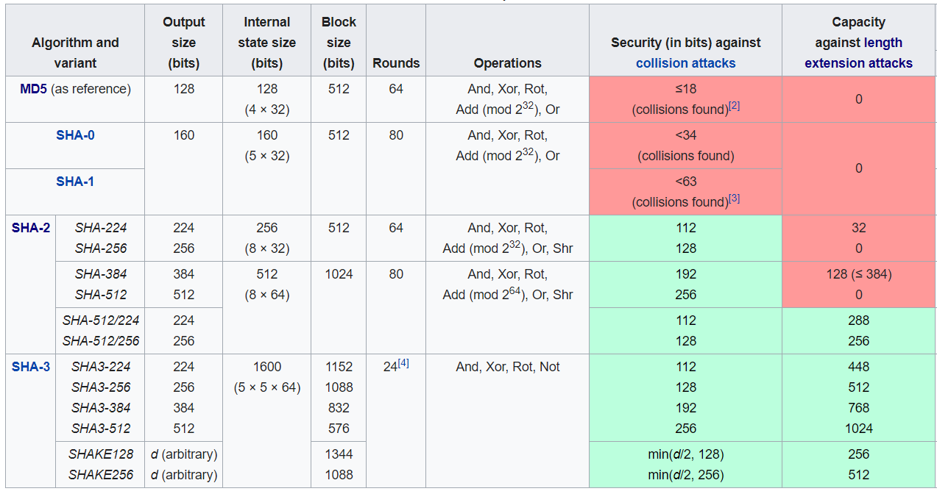
SHA-1, SHA-2, SHA-3
https://en.wikipedia.org/wiki/Secure_Hash_Algorithms

Slide 21
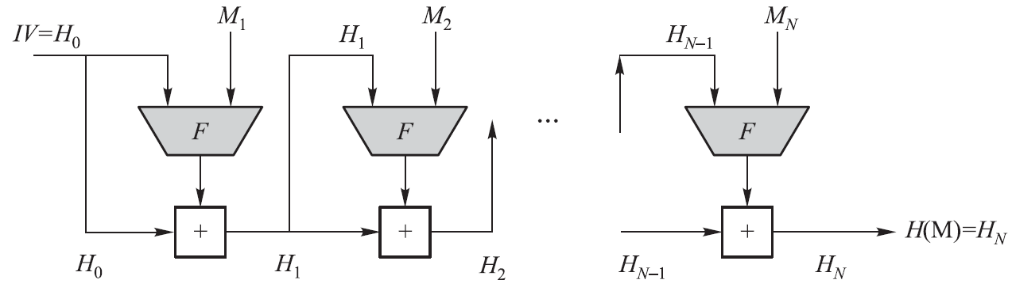
Merkle-Damgard Construction for Hash Functions
SHA-1, SHA-2 (a series of hash functions), and WHIRLPOOL all have the same basic structure
The heart of this basic structure is a compression function F
Different hash algorithms use different compression functions
Use a CBC mode of repeated applications of F without using secret keys
M is a plaintext block, IV is an initial vector, F is a compression function, and “+” is some form of modular addition operation
Notes:
CBC=Cipher block chaining

Slide 22
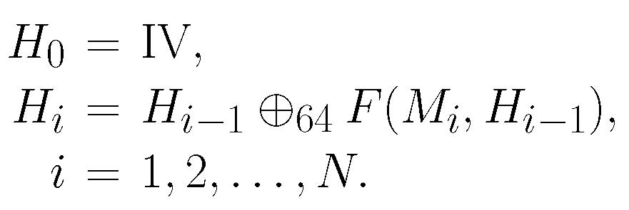
Merkle-Damgard Construction for Hash Functions
The M’s digital fingerprint is H(M) = H_{N}, where
SHA-512
Notes:
CBC=Cipher block chaining

Slide 23


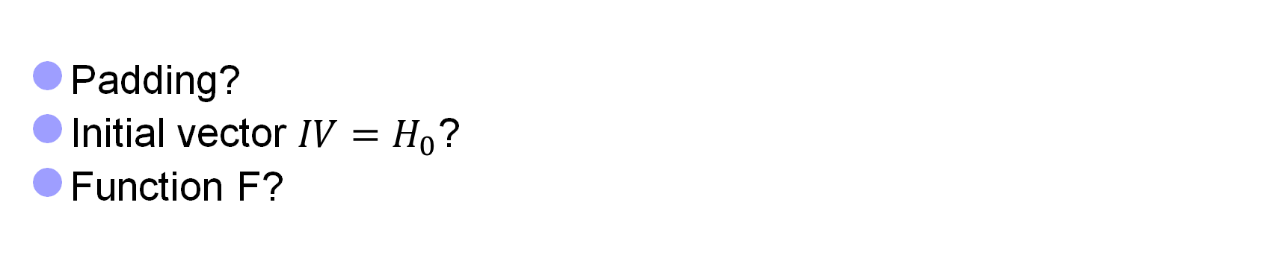
SHA-512 Algorithm
Let X = X₁X₂…X_{k}, Y = Y₁Y₂…Y_{k} be binary strings, where each X_{i},Y_{i} is an l-bit binary string. Generalize the bitwise-XOR operation to an l-bitwise-XOR operation as follows:
For SHA-512: $l=64$
Padding?
Initial vector ${IV=H}_{0}$?
Function F?
Y
X

Slide 24
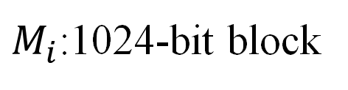
SHA-512 Initial Process (I)
Padding process
M M’= M₁M₂…M_{N}
$M_{i}$:1024-bit block
1024 bits
1024 bits
1024 bits?
Length(M)=L
M’ = M || 1(0^{l}) || b₁₂₈(L), where l ≥ 0

Slide 25
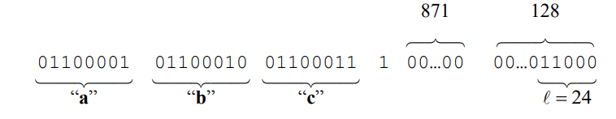
SHA-512 Initial Process (I)
Padding process
Example: M=abc
M’ (1024 bits)
Length(M)=24
M’ = M || 1(0^{l}) || b₁₂₈(L), where l =1024 -24 -1 -128 = 871
L

Slide 26
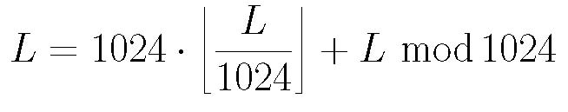
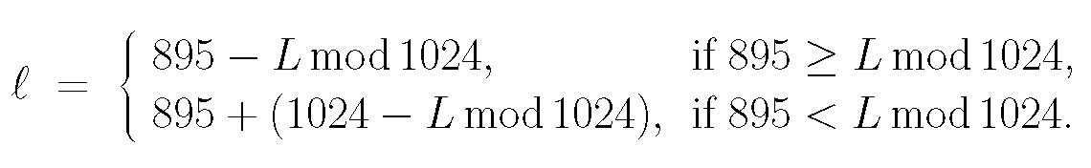

SHA-512 Initial Process (II)
Set Γ = 2¹²⁸ – 1 and γ = 512
M is a binary with |M| = L ≤ Γ
Represent L as a 128-bit binary string, denoted by b₁₂₈(L)
Pad M to produce a new binary string M’ as follows:
M’ = M || 1(0^{l}) || b₁₂₈(L), where l ≥ 0
such that |M’| (denoted by L’) is divisible by 1024. We have
L’ = L + (1 + l) + 128 = L + l + 129 = L + (1024 – 895) + l
L can be represented as
Hence, l can be determined as follows:
Thus, L’ is divisible by 1024. Let L’ = 1024N and write as a sequence of 1024-bit blocks: M’ = M₁M₂…M_{N}
Padding process
M M’
M’ = M || 1(0^{l}) || b₁₂₈(L),
where l ≥ 0
M’ = M₁M₂…M_{N}
$$len(M_{i}) =1024$$

Slide 27
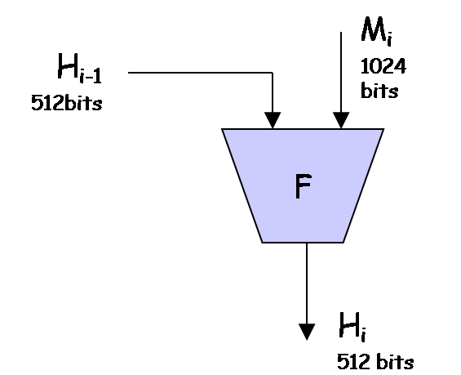

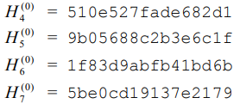


SHA-512 Initial Process (II)
SHA-512 uses a 512-bit IV
Let r₁, r₂, r₃, r₄, r₅, r₆, r_{7,} and r₈ be eight 64-bit registers
Initially they are set to, respectively, the 64-bit binary string in the prefix of the fractional component of the square root of the first 8 prime numbers:
√2, √3, √5, √7, √11, √13, √17, √19
$$H^{(0)}=\text{IV}$$

Slide 28
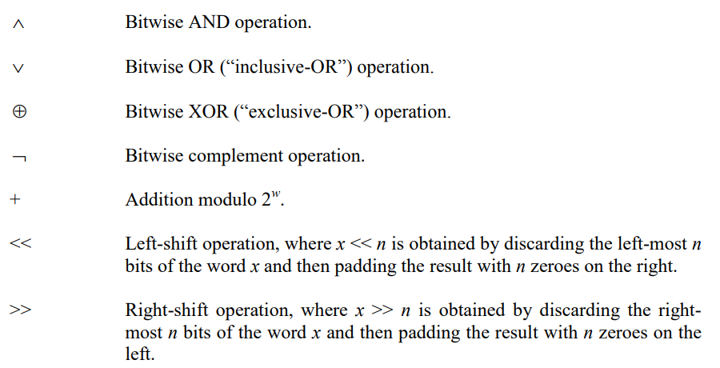
SHA-512 Compression Function (III)

Slide 29
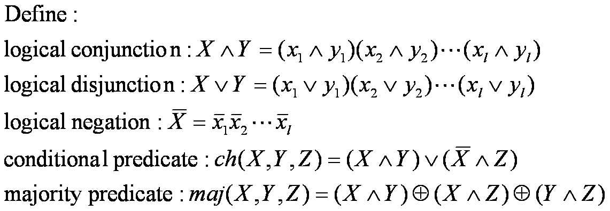
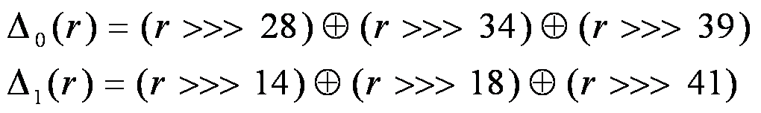
SHA-512 Compression Function (III)
Bitwise operations

Slide 30
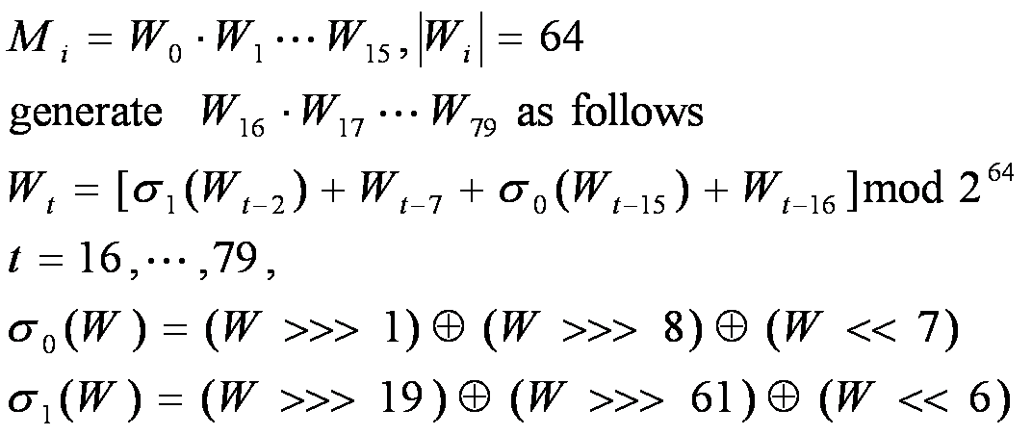
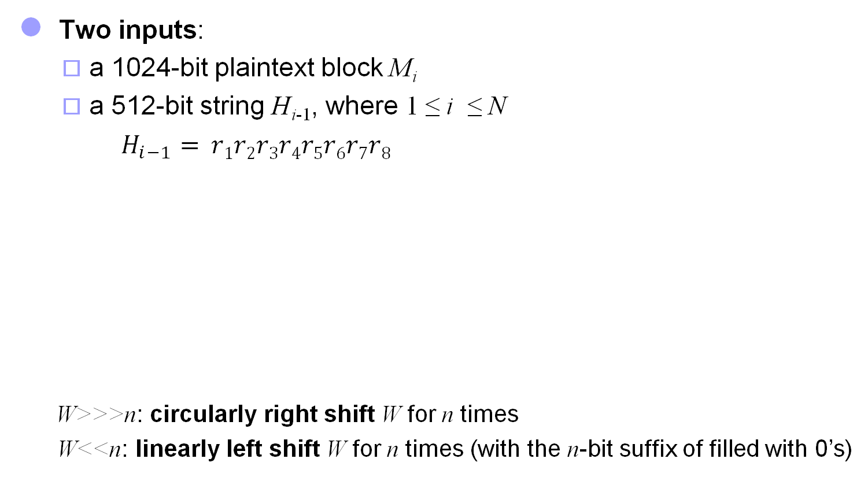
SHA-512 Compression Function (IlI)
Two inputs:
a 1024-bit plaintext block M_{i}
a 512-bit string H_{i-1}, where 1 ≤ i ≤ N
$H_{i−1}= r1r2r3r4r5r6r7r8$
W>>>n: circularly right shift W for n times
W<<n: linearly left shift W for n times (with the n-bit suffix of filled with 0’s)

Slide 31

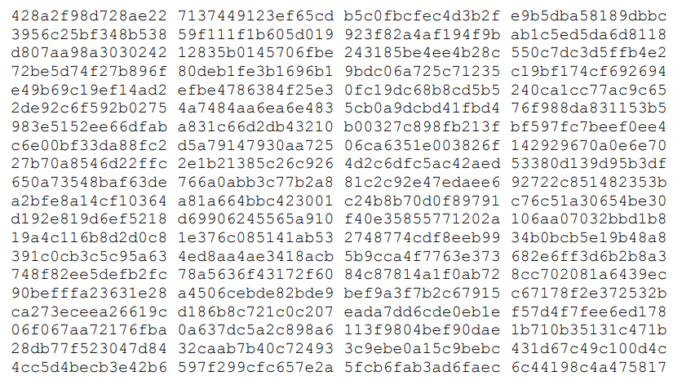
SHA-512 Compression Function (III)
: first sixty-four bits of the fractional parts of the cube roots of the first eighty prime numbers

Slide 32
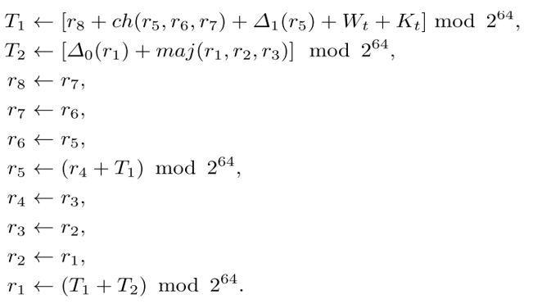

SHA-512 Compression Function (III)
$H_{i−1}= r1r2r3r4r5r6r7r8$, $W_{0},$ $W_{1},…,W_{79}$, $K_{0},$ $K_{1},…,K_{79}$
For each i is executed 80 rounds:
t=0,1,2,..79
After 80 rounds of executions, the output is 512-bit string
$F(Mi, H_{i−1} ) = r1r2r3r4r5r6r7r8$

Slide 33





Length extension attack on SHA2
$$EX$$
$$H_{N}$$
$$H^{∗}$$
$$H$$
$$H(K||M)=H(K||M||padded)$$
$$H(K||M||padded||EX) =H^{∗}(EX)$$
can compute $H(M||padded||EX)$without knowing the input $M$
$$H(M|\left|K\right)−→OK$$

Slide 34
SHA3 Standard
SHA-3 provides an alternative to SHA-2, and is drop-in compatible with any system using SHA-2
SHA-3 uses a sponge construction, instead of the CBC mode of repeated compressions used by SHA-1, SHA-2, and Whirlpool
https://nvlpubs.nist.gov/nistpubs/FIPS/NIST.FIPS.202.pdf

Slide 35
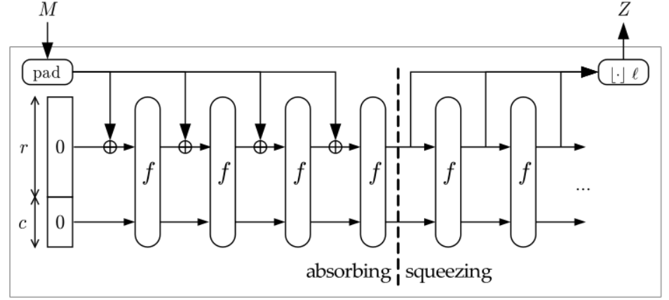
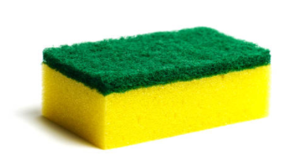
SHA3 Standard
Sponge construction
Let M be the input string; γ = the hash length.
b = r + c, where c = 2γ
r is called rate and c capacity
Where

